Slide 1

Predicting customer buying behavior

Slide 2
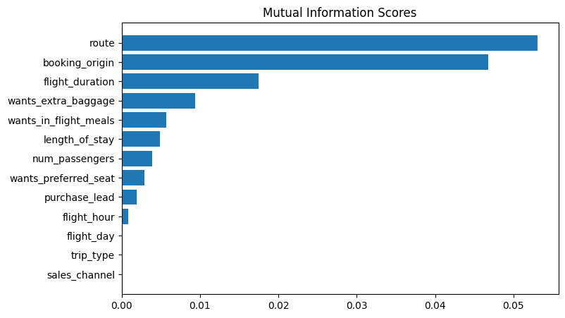
predictive model to understand factors that influence buying behavior
We have trained the data set with Random forest classifier model and received
ACCURACY: 83.36
AUC score: 0.565
route
booking_origin
flight_duration
wants_extra_baggage
Wants_in_flight_meals
are the top 5 features which influence
Customer buying behavior
We need to increase the AUC score.

